Slide 1
Module 3- WINDOWS INSTALLATION AND CONFIGURATION
1- Different part of an operating system
2- Different way to install an operating system
3- Download the OS on Microsoft website: technet.microsoft.com
4- Creating a virtual machine
5- Installing Windows server 2016
6- Adding resources
7- Hostname and system information
8- Windows server GUI overview
9- Quiz
10- Homework

Slide 2
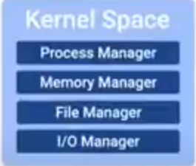
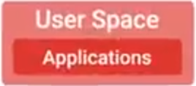
1- Different part of an operating system.
What’s an operating system?
The whole package that manages our computer’s resources and let us interact with it.
There are 2 main parts of an OS
The kernel is main core of the OS, it talks directly to our hardware and manages our system resources.
User space it’s basically everything outside the kernel and things that we interact directly like: system programs, user interfaces etc.….
We have a lot of operating system out there but on this training we will talk about WINDOWS & LINUX.

Slide 3
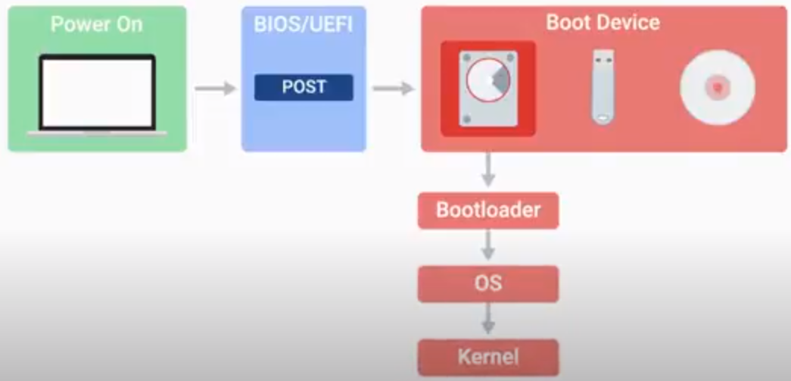
Boot Process
In this lesson we are going to learn how our operating system starts up.
As a system admin it’s important to know the steps that an operating system takes so you can help diagnose some issues where computers won’t start.
Booting a computer means to start from nothing and follow the series of steps to arrive at the fully operating system.
BIOS/UEFI: it’s a low level software that initializes our computer hardware to make sure everything is good to go.
Bootloader it’s a small program that loads the operating system.

Slide 4
The CPU Architecture
We have 2 different types cpu architecture:
32 bits
64 bits
The operating system will also be optimize for this architecture so make sure the cpu and os are compatible.
If you have a 64 bits cpu you should also install a 64 bits version of the operating system.
32-bit and 64-bit are commonly used to describe processor architecture or design. A 32-bit processor includes a 32-bit register, which can store 2³² or 4,294,967,296 values. A 64-bit processor includes a 64-bit register, which can store 2⁶⁴ or 18,446,744,073,709,551,616 values. Therefore, a 64-bit register is not twice as large as a 32-bit register, but is 4,294,967,296 times larger

Slide 5
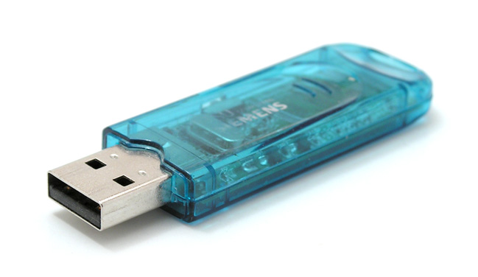
DIFFERENT WAY TO INSTALL WINDOWS
Install windows with an USB key
What you need
Windows 10 install .iso or DVD
USB flash drive with at least 5GB free space. This drive will be formatted, so make sure it doesn't have any important files on it.
Technician PC - Windows PC that you'll use to format the USB flash drive
Destination PC - A PC that you'll install Windows on

Slide 6
Step 1 - Format the drive and set the primary partition as active
Connect the USB flash drive to your technician PC.
Open Disk Management: Right-click on Start and choose Disk Management.
Format the partition: Right-click the USB drive partition and choose Format. Select the FAT32 file system to be able to boot either BIOS-based or UEFI-based PCs.
Set the partition as active: Right-click the USB drive partition and click Mark Partition as Active.

Slide 7
Step 2 - Copy Windows Setup to the USB flash drive 1- Use File Explorer to copy and paste the entire contents of the Windows product DVD or ISO to the USB flash drive.
Step 3 - Install Windows to the new PC
Connect the USB flash drive to a new PC.
Turn on the PC and press the key that opens the boot-device selection menu for the computer, such as the Esc/F10/F12 keys. Select the option that boots the PC from the USB flash drive.
Windows Setup starts. Follow the instructions to install Windows.
Remove the USB flash drive.

Slide 8
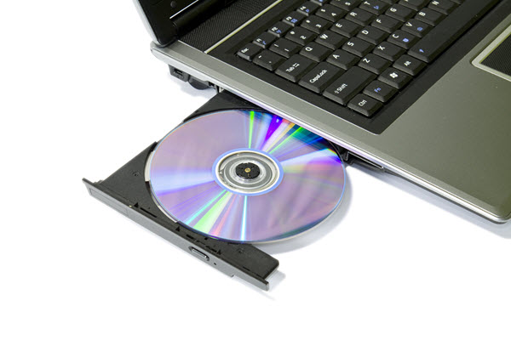
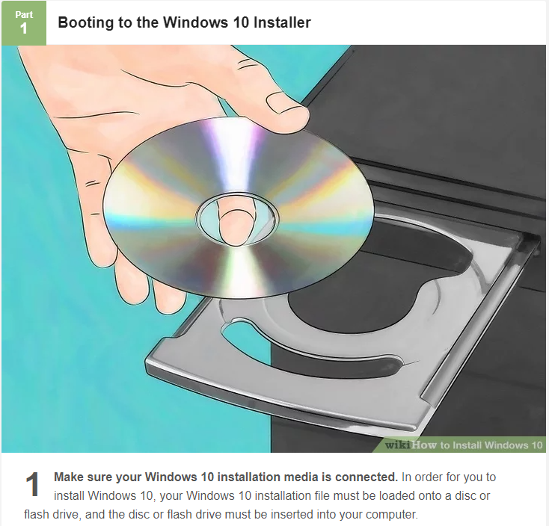
Installing windows with DVD

Slide 9
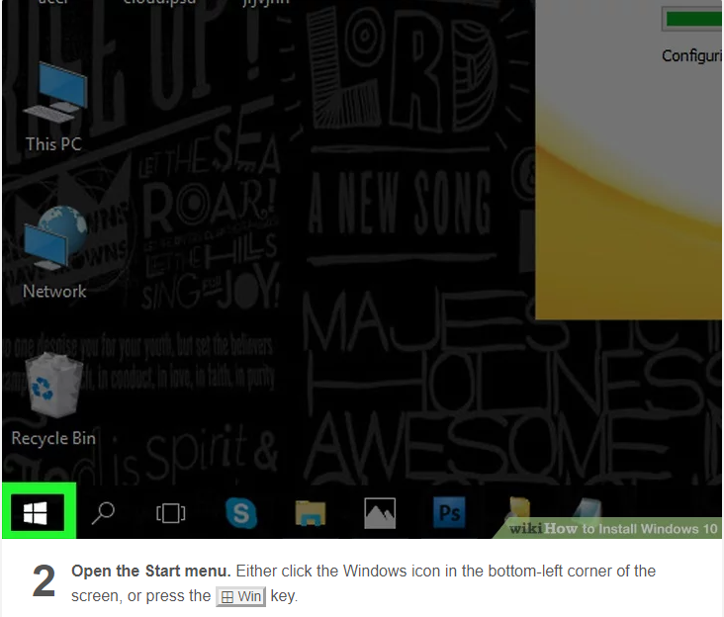

Slide 10
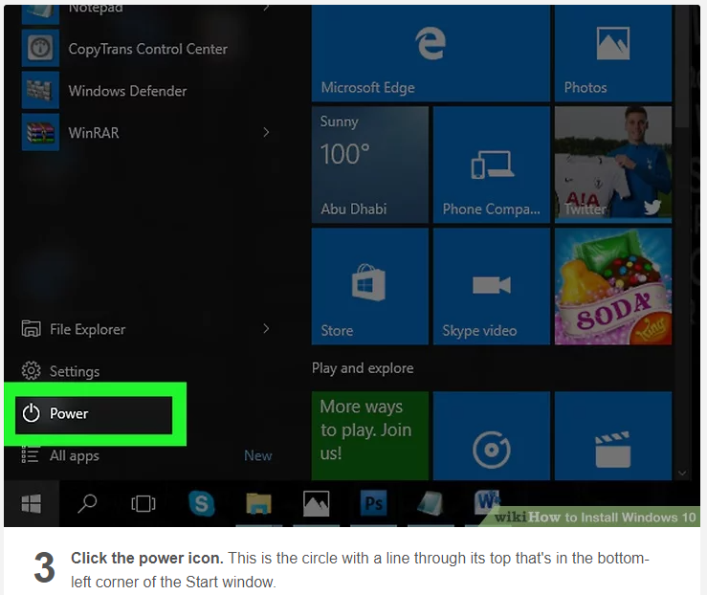

Slide 11
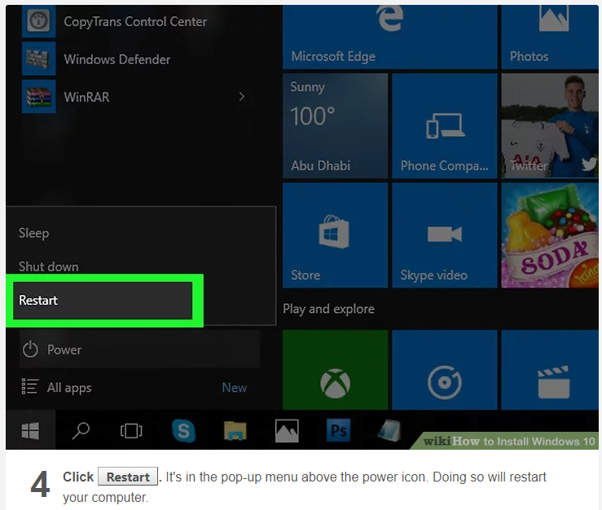

Slide 12
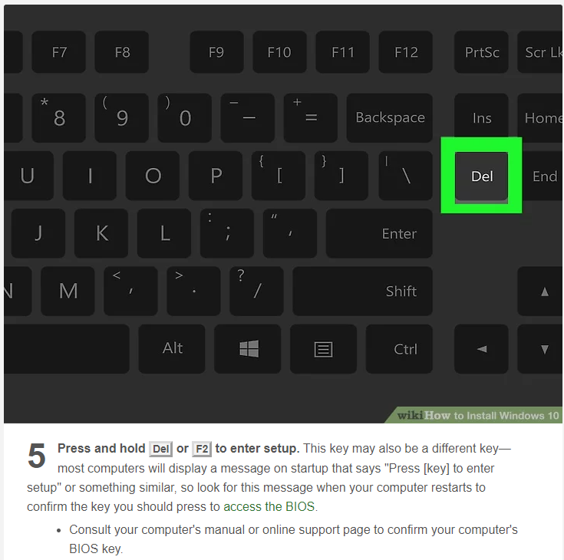

Slide 13
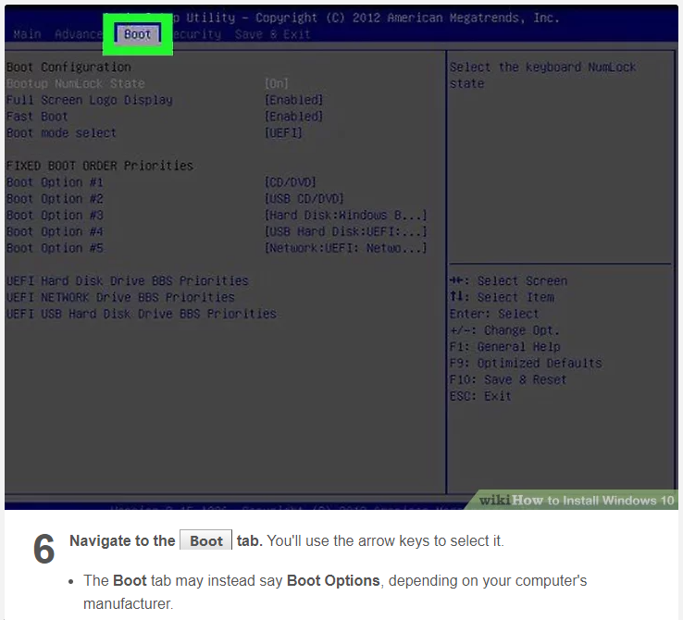

Slide 14
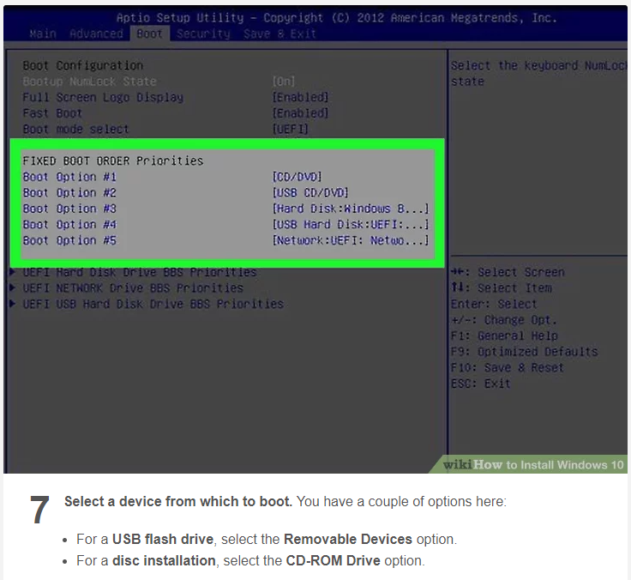

Slide 15
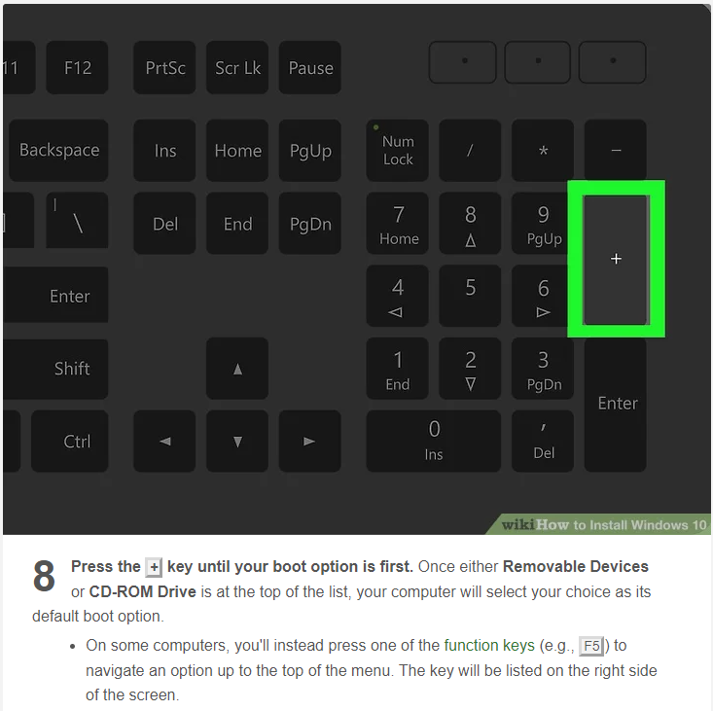

Slide 16
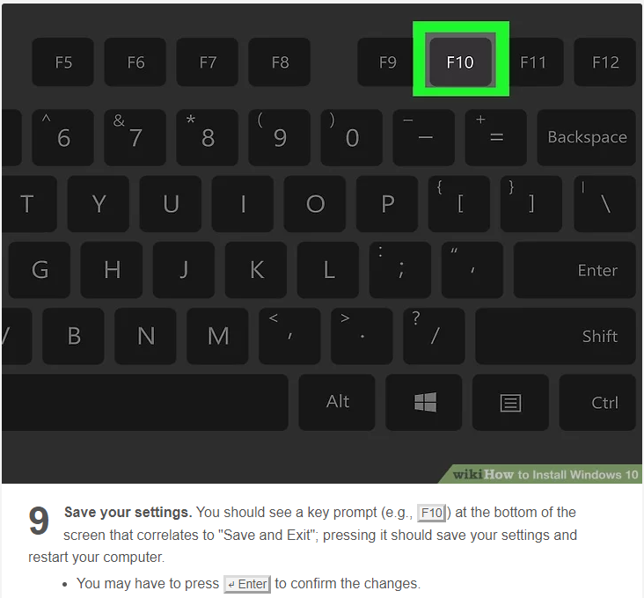

Slide 17
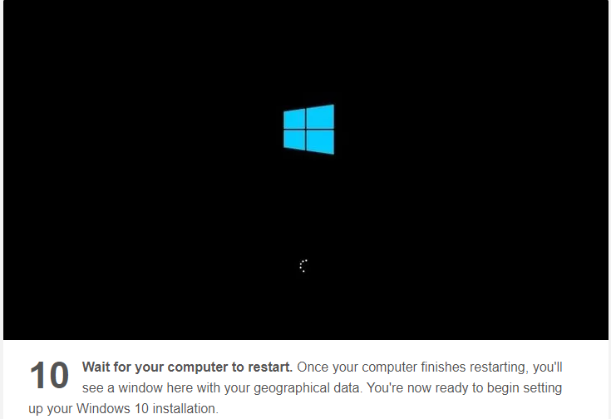

Slide 18
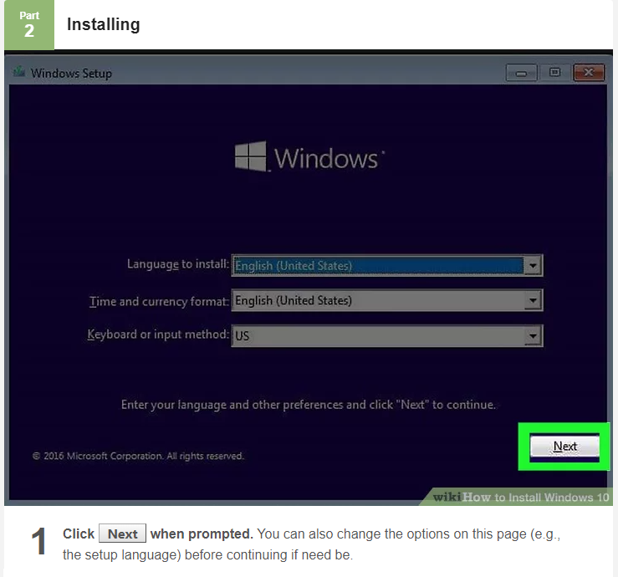

Slide 19
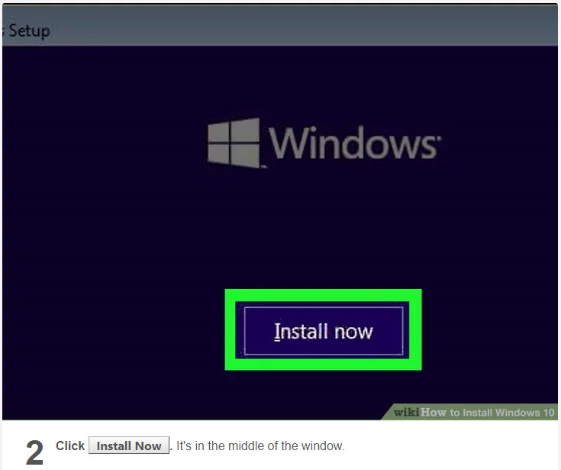

Slide 20
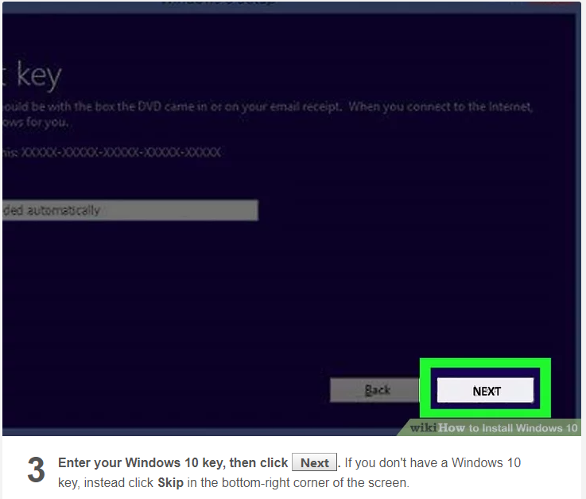

Slide 21
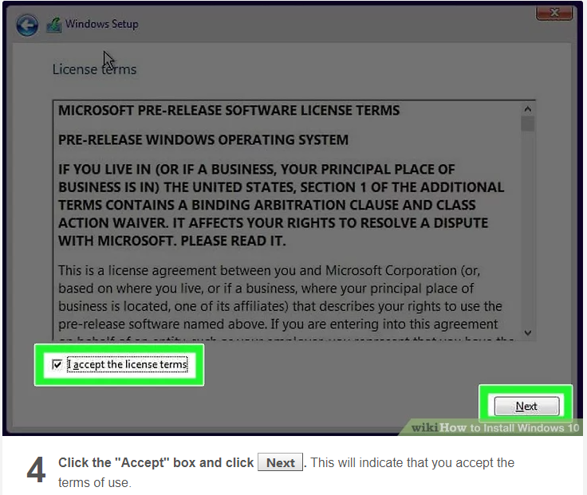

Slide 22
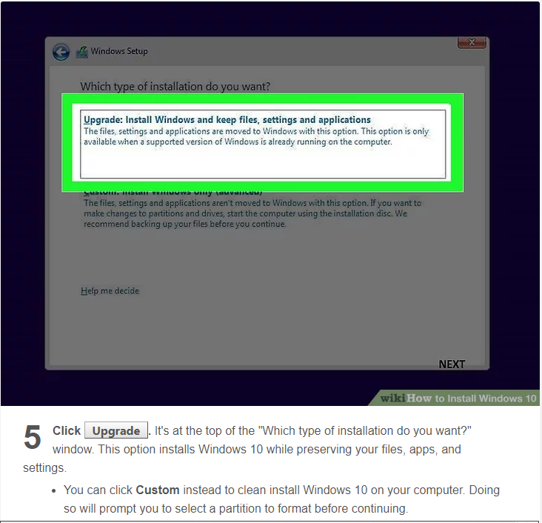

Slide 23
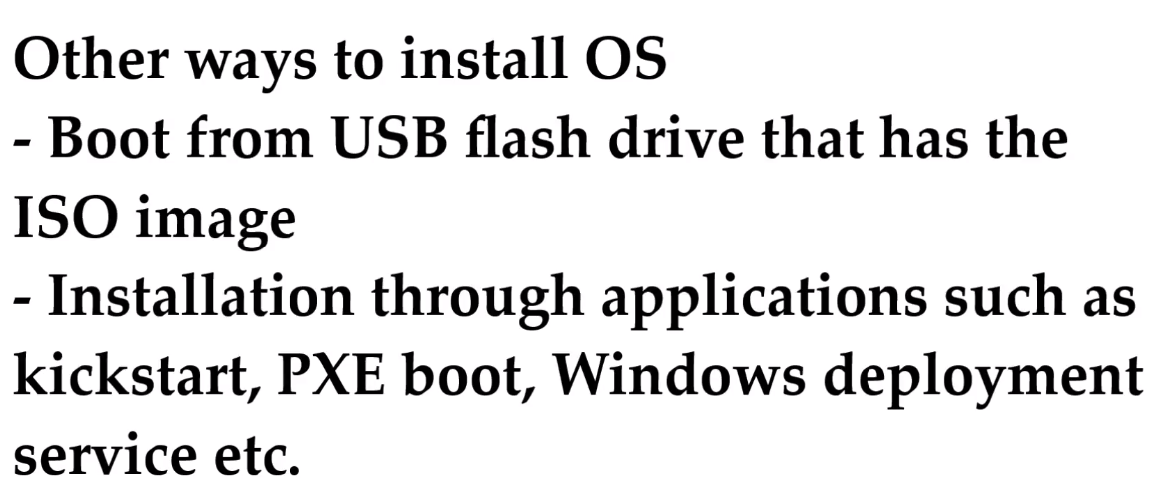

Slide 24
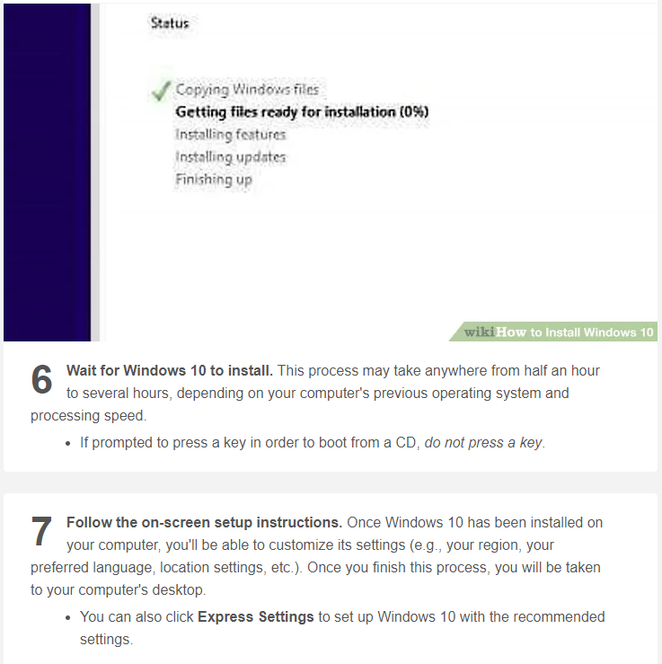

Slide 25
Downloading the OS on Microsoft website
Windows server 2016
LINK: https://www.microsoft.com/en-us/evalcenter/evaluate-windows-server-2016
Windows 10
https://www.microsoft.com/en-us/evalcenter/evaluate-windows-10-enterprise

Slide 26
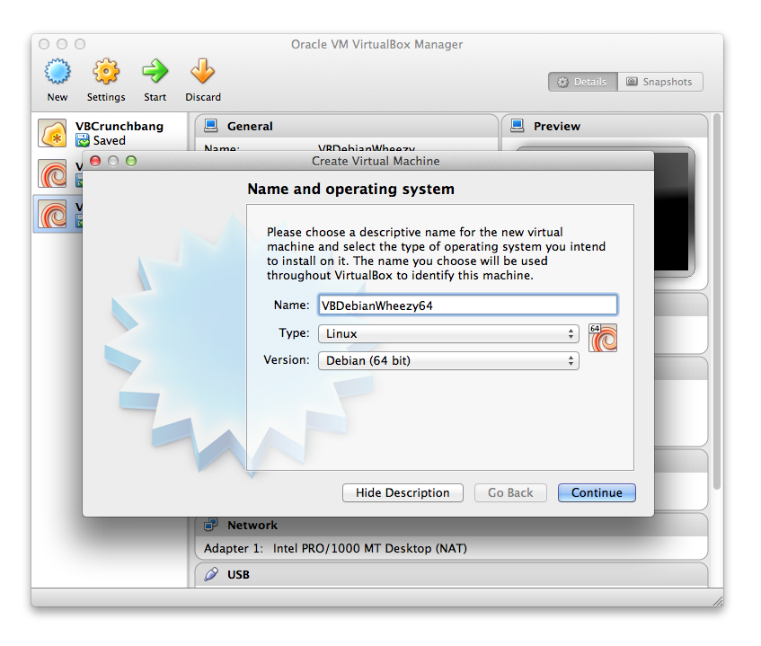
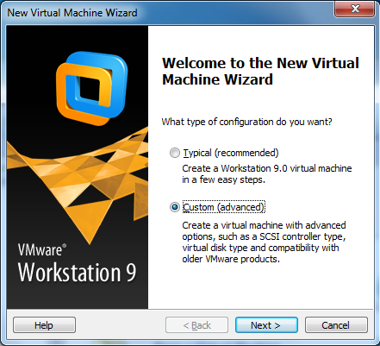
Creating virtual Machine
This Photo by Unknown Author is licensed under CC BY-SA

Slide 27
Adding resources to virtual machine(VM)
verify if you have enough resources in your physical machine.
add cpu and memory (ram) to VM

Slide 28
HOSTNAME AND SYSTEM INFORMATION
How to change hostname
The hostname is a freely selectable name for a host. For example, you could call a server in a company network responsible for the central administration of emails “mail” or “mail123”.
Check system Information

Slide 29
Windows server GUI overview
Desktop
Start menu
Task bar
Search bar

Slide 30
QUIZ
Which one of the following is not a method to install an operating system?
​
Attached ISO
1) Which one of the following is not a method to install an operating system?
a) Attached ISO
b) Run executable file in BIOS
c) Network Boot
d) Insert a CD or DVD
2) Which of the following can be pre-installed with the hardware?
User application b) Operating system c) None of the above
3) What is the url to download Microsoft Windows Server ISO?
a) Technet.windows.com b) Microsoft.technet.com c) Technet.Microsoft.com

Slide 31
QUIZ
4) For how many days Windows evaluation is for?
172 ; b) 190 ; c) 180 ; d) 150
5) Which key can be use to release mouse from the VM window?
Esc b) Alt+Ctrl+Del c) Enter d) Right Ctrl
6) Which Windows 2016 operating system has the most features?
Windows server Datacenter (Desktop experience)
Windows 2016 Datacenter
Widows 2016 standard Evaluation (Desktop experience)
Windows 2016 Standard Evaluation

Slide 32
QUIZ
8) Which of the following resources can be added to a VM?
Ram b) Hard drive c) CPU d) All of the above
9) How to change Windows server hostname?
Server Manager then tools then computer management
Server Manager then Manage then Server Manager properties
Server Manager then tool then computer services
My pc then properties then change settings

